Slide 1
AIRLINE PRICE PREDICTION
Presented by
BVM Anirudh-ENG17CS0048
Deepak R Purohit-ENG17CS0062
Devansh Awasthi-ENG17CS0065
Dhruva Santhosh-ENG17CS0070

Slide 2
Table Of Contents
INTRODUCTION
REQUIREMENT SPECIFICATION
PARAMETERS AFFECTING PRICING
USE CASE DIAGRAMS
ALGORITHMS
FEATURES OF DATA SETS
CONCLUSION

Slide 3
INTRODUCTION:
Nowadays, airline ticket prices can vary dynamically and significantly for the same flight, even for nearby seats within the same cabin. Customers are seeking to get the lowest price while airlines are trying to keep their overall revenue as high as possible and maximize their profit.
Airlines use various kinds of computational techniques to increase their revenue such as demand prediction and price discrimination.
From the customer side, two kinds of models are proposed by different researchers to save money for customers: models that predict the optimal time to buy a ticket and models that predict the minimum ticket price.
The airline industry is considered as one of the most sophisticated industry in using complex pricing strategies. Nowadays, ticket prices can vary dynamically and significantly for the same flight, even for nearby.

Slide 4
The ticket price of a specific flight can change up to 7 times a day .Customers are seeking to get the lowest price for their ticket, while airline companies are trying to keep their overall revenue as high as possible and maximize their profit.
However, mismatches between available seats and passenger demand usually leads to either the customer paying more or the airlines company loosing revenue.
Customer side researches focus on saving money for the customer while airline side studies are aimed at increasing the revenue of the airlines.
Conducted researches employ a variety of techniques ranging from statistical techniques such as regression to different kinds of advanced data mining techniques.

Slide 5
dynamic pricing enables a more optimal forecasting of ticket prices based on vibrant factors such as changes in demand and price discrimination.
dynamic pricing is challenging as it is highly influenced by various factors including internal factors, external factors, competition among airlines and strategic customers.
Internal factors consist of features such as historical ticket price data, ticket purchase date and departure date, season, holidays, supply (number of available airlines and flights), fare class, availability of seats, recent market demand and flight distance.
External factors include features such as occurrence of some event at the origin or destination city like terrorist attacks, natural disaster (hurricane, earthquake, tsunami, etc.), political instability (protest, strike, coup, resignation), concerts, festivals, conferences, political gatherings and sports events, competitors’ promotions, weather conditions and economic activities.

Slide 6
REQUIREMENT SPECIFICATION
SOFTWARE REQUIREMENTS:
Python 3.8 version
Jupiter Notebook
Modules required: Numpy, Pandas, Matplotlib, Seaborn, sklearn
HARDWARE REQUIREMENTS:
Windows 7/8/10 ,Linux,Macos operating systems
Processors: intel Atom or intel core 3 or more processor.
RAM:8GB or more
Disk space:1GB or more

Slide 7
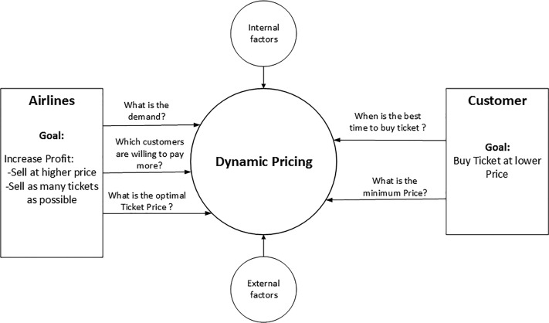


Slide 8
PARAMETERS THAT AFFECT PRICING
Date of Journey
Number of stops (Layovers)
Flight Time
Source
Destination
Additional Information
Airline

Slide 9
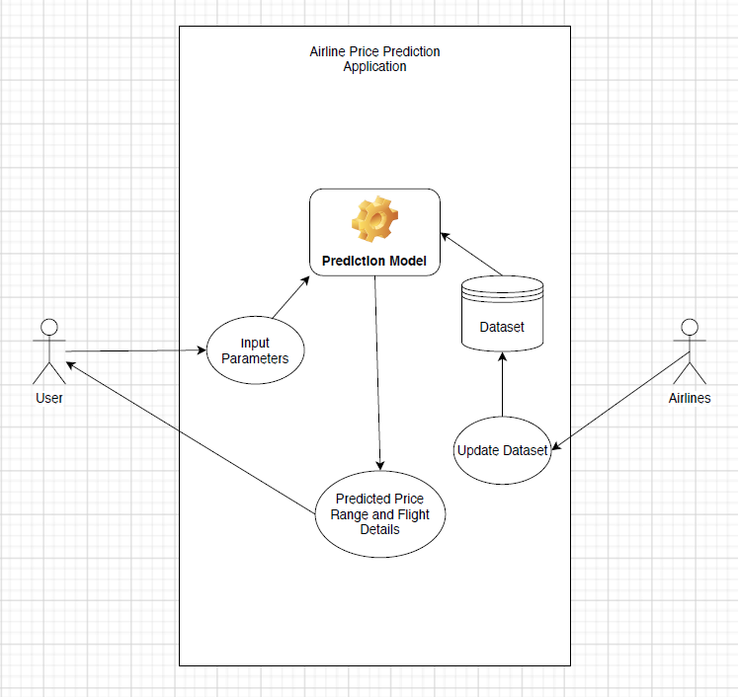
Use Case Diagram

Slide 10
User: The user enters the parameters which are inserted in prediction model and yhe predicted prices for the given dates are shown to the User
Input Parameters: These include the date, previous dates, festive and non- festive seasons, availability of seats etc.
Dataset: These are the prices for airline seats according to its availability for given date for different destinations.
Airlines: The given airline will access the given details for the passengers and change the prices for each seat according to the demand

Slide 11
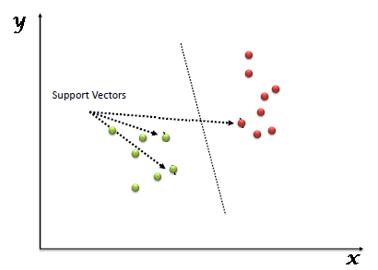
ALGORITHMS:
1)Support Vector Machine:
The objective of the support vector machine algorithm is to find a hyperplane in an N-dimensional space(N — the number of features) that distinctly classifies the data points.
Support Vector Machine (SVM) is a supervised machine learning algorithm which can be used for both classification or regression challenges. However, it is mostly used in classification problems.

Slide 12
APPLICATIONS OF SVR:
Classification of satellite data like SAR data using supervised SVM.
Hand-written characters can be recognized using SVM.
The SVM algorithm has been widely applied in the biological and other sciences.
They have been used to classify proteins with up to 90% of the compounds classified correctly

Slide 13
Decision Tree Regressor:
Decision Tree algorithm belongs to the family of supervised learning algorithms.
Unlike other supervised learning algorithms, the decision tree algorithm can be used for solving regression and classification problems too.
The goal of using a Decision Tree is to create a training model that can use to predict the class or value of the target variable by learning simple decision rules inferred from prior data(training data).
In Decision Trees, for predicting a class label for a record we start from the root of the tree. We compare the values of the root attribute with the record’s attribute. On the basis of comparison, we follow the branch corresponding to that value and jump to the next node

Slide 14
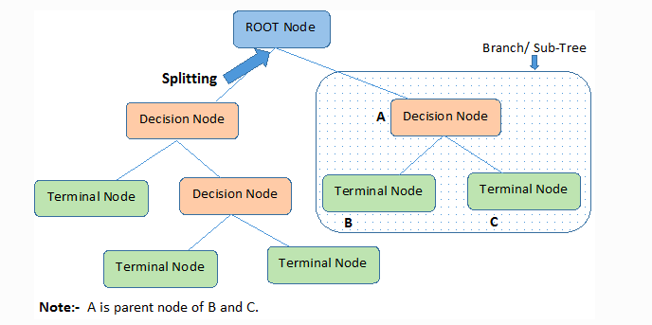
Decision trees are used for handling non-linear data sets effectively.
The decision tree tool is used in real life in many areas, such as engineering, civil planning, law, and business.

Slide 15
Random Forest Regressor:
Random forest is a supervised learning algorithm which is used for both classification as well as regression.
But however, it is mainly used for classification problems. As we know that a forest is made up of trees and more trees means more robust forest.
Similarly, random forest algorithm creates decision trees on data samples and then gets the prediction from each of them and finally selects the best solution by means of voting.
It is an ensemble method which is better than a single decision tree because it reduces the over-fitting by averaging the result.

Slide 16
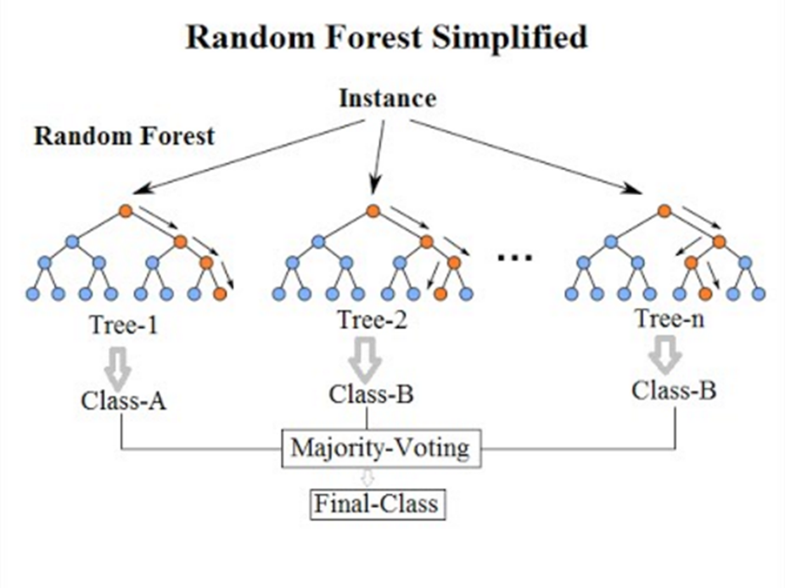
Applications of random forest:
In finance, for example, it is used to detect customers more likely to repay their debt on time, or use a bank's services more frequently. In this domain it is also used to detect fraudsters out to scam the bank.
In trading, the algorithm can be used to determine a stock's future behavior.
In the healthcare domain it is used to identify the correct combination of components in medicine and to analyze a patient’s medical history to identify diseases.
Random forest is used in e-commerce to determine whether a customer will actually like the product or not.

Slide 17
Gradient Boost Algorithm:
In boosting, each new tree is a fit on a modified version of the original data set. The gradient boosting algorithm (gbm) can be most easily explained by first introducing the AdaBoost Algorithm.
The AdaBoost Algorithm begins by training a decision tree in which each observation is assigned an equal weight.
After evaluating the first tree, we increase the weights of those observations that are difficult to classify and lower the weights for those that are easy to classify.
The second tree is therefore grown on this weighted data. Here, the idea is to improve upon the predictions of the first tree. Our new model is therefore Tree 1 + Tree 2. We then compute the classification error from this new 2-tree ensemble model and grow a third tree to predict the revised residuals.
We repeat this process for a specified number of iterations. Subsequent trees help us to classify observations that are not well classified by the previous trees. Predictions of the final ensemble model is therefore the weighted sum of the predictions made by the previous tree models.

Slide 18
FEATURES OF DATA SETS:
Airline: The name of the airline.
Date_of_Journey: The date of the journey
Source: The source from which the service begins.
Destination: The destination where the service ends.
Route: The route taken by the flight to reach the destination.
Dep_Time: The time when the journey starts from the source.
Arrival_Time: Time of arrival at the destination.
Duration: Total duration of the flight.
Total_Stops: Total stops between the source and destination.
Additional_Info: Additional information about the flight
Price: The price of the ticket A regression problem in which duration, source, destination, dates of flight and route are provided

Slide 19
CONCLUSION:
The advantages of travelling by airplanes have increased overtime.
The industry tries to make the ticket fare reasonable as well as to make profit out of it. Airline industry has lots of dynamic factors affecting them in a day today operation.
It’s one of the highly sophisticated industry which aims at making revenue. The purpose of this study is to better analyze the features that affect airfare and develop and tune models to predict the airfare well in advance.
We used XGBoost and Keras with a Tensorflow backend Neural Network, two state of the art prediction models for our study and used various machine learning tasks to achieve the best performance for our task.

Slide 20
THANK
YOU

